Slide 1
Federation Membership Meeting & Public Safety Program
Kelly Rankin LCSW, CSAC
Substance Abuse Prevention Specialist
Fairfax County Public Schools
Krankin@fcps.edu
703-287-2744

Slide 2
Substance Abuse Prevention Specialists (SAPS)
Each school pyramid has a Substance Abuse Prevention Specialist (SAPS) assigned to provide substance abuse prevention, education, and intervention services. Substance Abuse Prevention Specialists are part of the FCPS Office of Student Safety and Wellness.
Key roles of a Substance Abuse Prevention Specialist:
Alcohol, Tobacco, and Other Drug (ATOD) education for students, parents, and the Fairfax County Community.
Intervention services upon violation of the Student Rights and Responsibilities (SR&R) or suspected substance abuse involvement.
Assessing a student’s level of substance use and, if appropriate, making referrals to Fairfax Community Service Board for additional services.
Group and individual prevention services for students, staff, parents, and the Fairfax County community.
Most importantly, building positive relationships with students to provide support and encouragement!
Parent permission is required.
Notes:
Who are we and what do we do?

Slide 3
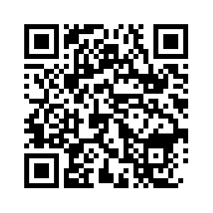
2022-2023 Youth Survey
Mental health concerns are trending down from last year
Substance Use reaches historic lows among Fairfax County Youth
Physical activity and amount of sleep improved
Extracurricular/volunteer activities improved but still lower than pre-pandemic levels
Most students feel safe at school and supported at home
Scan here to see the full youth survey results

Slide 4
Phones and Social Media
Monitor Phones Especially Social Media
What to watch out for:
Phones-most activities good or bad is done via text or social media. If you aren’t sure what an emoji means look it up
Kids tend to have the account approved by parents and then a secret account(s) parents don’t know about.
Making videos
IDG Communications (2020)

Slide 5
What Are Opioids?
Opioids is a term used for the entire family of opiate drugs, including natural, synthetic and semi-synthetic.
Opiates-refers to any drug that is derived from the naturally occurring opium alkaloid compounds that are found in the poppy plant. Types of opiate drugs include opium, codeine, morphine.
These drugs are chemically related and interact with opioid receptors on nerve cells in the body and brain.
OPIOID DRUGS INCLUDE:
Heroin
Buprenorphine
Codeine
Fentanyl
Hydrocodone
Percocet = Oxycodone + Acetaminophen
source: opioidtaskforcewc.org
Notes:
FCPS SAPS: Kelly
Opioids is a term used for the entire family of opiate drugs, including natural, synthetic and semi-syntenic
Opiates-refers to any drug that is derived from the naturally occurring opium alkaloid compounds that are found in the poppy plant. Types of opiate drugs include opium, codeine, morphine.
opioid, on the other hand, is broader and refers to any drug synthesized from an opiate that produces similar effects.
Natural- natural opioids are naturally occurring substances extracted from the seed pod of certain varieties of poppy plants
Semi-synthetic opioids include, hydrocodone, and oxycodone (the prescription drug OxyContin), as well as heroin, which is made from morphine.
Fully synthetic opioids are opioids that are completely manmade, including fentanyl, tramadol
Examples of Opioid Drugs include heroin (illegal), Oxycodone, Percocet (often prescribed for pain). Morphine is often given in hospitals for surgery

Slide 6
A Little History The three phases of the opioid crisis
2005- Doctors stop over prescribing resulting to addicts getting pills on the street. Heroin becomes popular because its cheaper.
Heroin Fentanyl
1996-Big Pharma introduces OxyContin as a non-addictive pain medication. It was aggressively marketed and the start of our opioid epidemic. What we know now is the data was wrong and OxyContin is highly addictive.
PILLS
2011 Fentanyl is added to Heroin and the overdoses skyrocket. Average age 22-30
2016 Fentanyl is added to other drugs.
2021 Counterfeit pills become the new trend. Under 18 showing up on the overdose data
Counterfeit pills

Slide 7
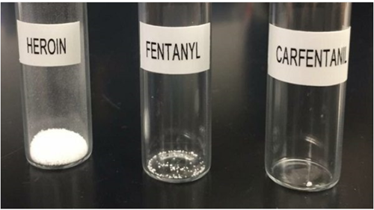
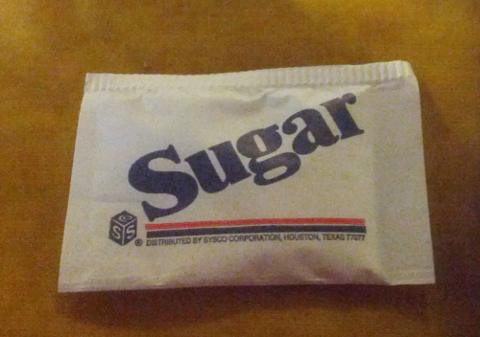
Why is Fentanyl So Dangerous?
Only 2 milligrams of Fentanyl is considered a lethal amount, depending on the size of the person.
To appreciate how small 2 milligrams is, a typical sweetener packet on a restaurant table contains approximately 1,000 milligrams.
DEA.GOV
This Photo by Unknown Author is licensed under CC BY-SA
Notes:
Kelly

Slide 8
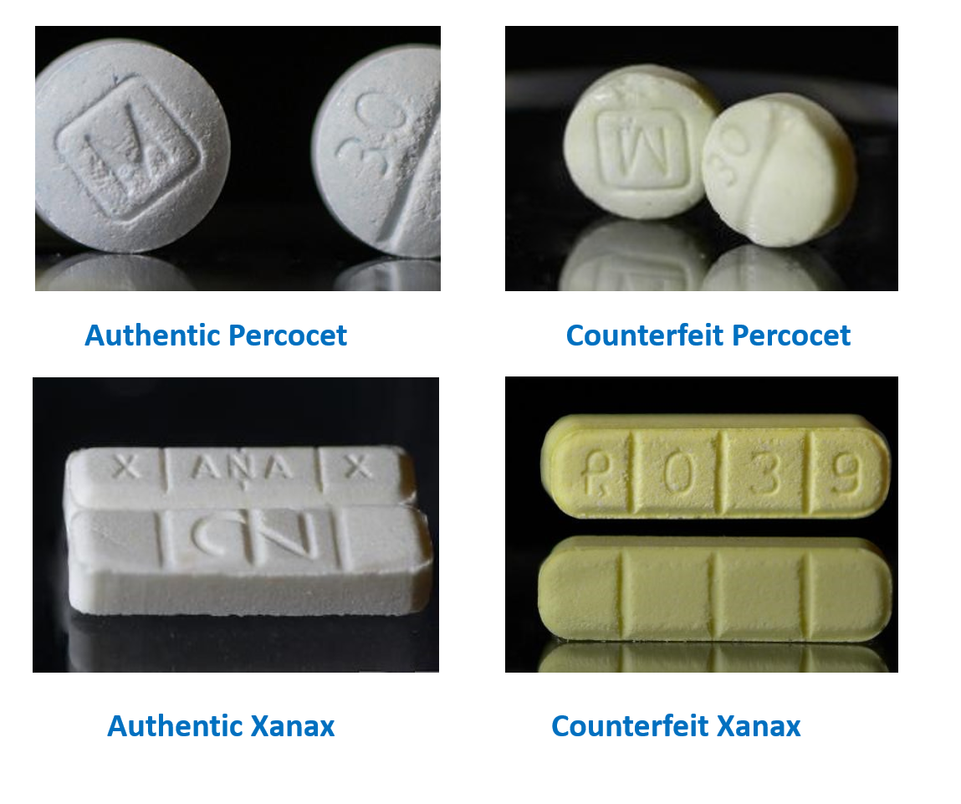
Counterfeit pills
Notes:
FCPD – Anne Rizza
These are some examples of authentic and counterfeit drugs
The labeling in these instances is more significant to investigators than those obtaining them – many times, as I stated before, they are looking for the high and are not overly concerned about the drug that gets them there
Our detectives have been seeing more light blue pills recently

Slide 9
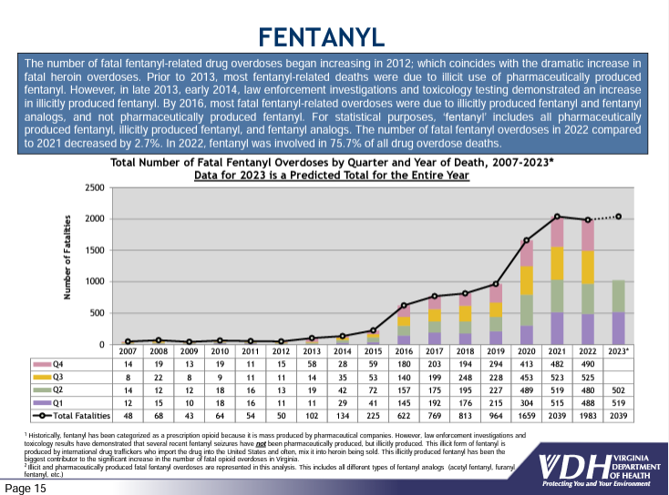
The number of fatal fentanyl overdoses in 2022 compared to 2021 decreased by 2.7%. In 2022, fentanyl was involved in 75.7% of all drug overdose deaths.

Slide 10
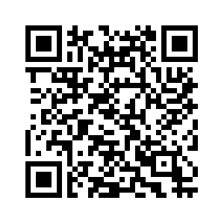
Opioid Overdoses in the Fairfax Health District
February 16, 2023: To increase transparency and community awareness, the Fairfax County Health Department has updated the Opioid Overdoses Dashboard. These changes better inform residents about trends in non-fatal and fatal opioid overdoses in the Fairfax Health District. See details at: Opioid

Slide 12
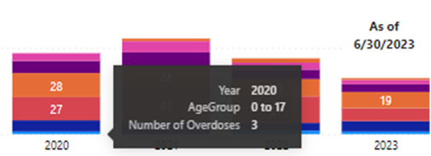
2020

Slide 13
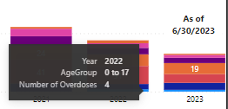

Slide 14
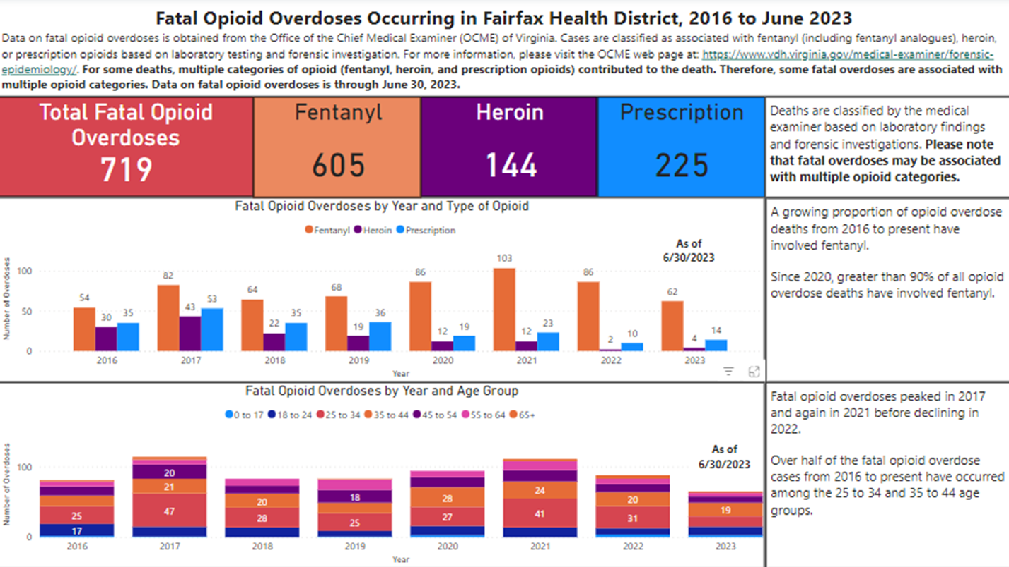
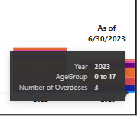
2023

Slide 15
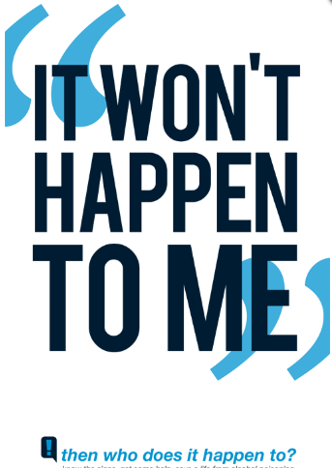
https://awareawakealive.org/

Slide 16
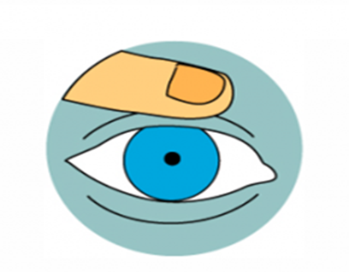
What Does an Opioid Overdose Look Like?
KNOW THE SIGNS
Not Responding
Doesn’t move and can’t be woken
Slow or Not Breathing
A breath every 5 seconds is normal
Making Sounds
Chocking, gurgling sounds, or snoring
Blue Lips & Nails
Cold or Clammy Skin
Tiny Pupils
source: kingcounty.gov
Notes:
FCPS SAPS: Kelly
Not responding, Slow or not breathing, making a gurgling or snoring sound, blue lips, cold or clammy skin, tiny puplis
There is a misconception among our your that getting help for someone might get them in trouble.
It’s important to teach our children that they could be saving a life.
If you have to ask yourself if they are OK, they are not OK, get help

Slide 17
Naloxone is the only effective response to an opioid overdose emergency!
Nothing else will work – vomiting, ice baths, other drugs, slapping, etc.
Notes:
DO NOT put the individual in a bath. They could drown.
DO NOT induce vomiting or give the individual something to drink. They could choke.
DO NOT put the person in an ice bath or put ice in their clothing or in any bodily orifices. Cooling down the core temperature of an individual who is experiencing an opioid overdose emergency is dangerous because it can further depress their heart rate.
DO NOT try and stimulate the individual in a way that could cause harm, such as slapping them hard, kicking them, or other more aggressive actions that may cause long-term physical damage.
DO NOT inject them with any foreign substances (e.g., salt water or milk) or other drugs or force them to eat or drink anything. It will not help reverse the overdose and may expose the individual to bacterial or viral infection, abscesses, endocarditis, cellulitis, choking, etc.

Slide 18
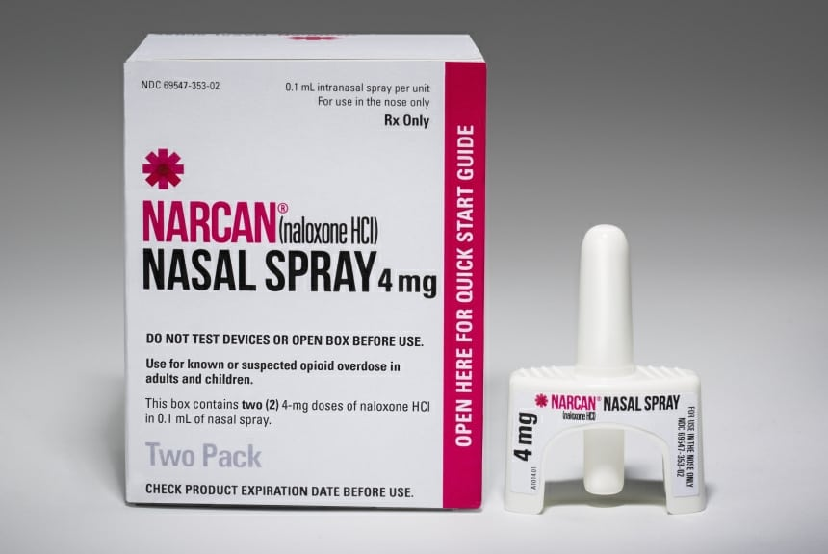
Narcan/Naloxone
Naloxone is a medicine that rapidly reverses an opioid overdose.
This means that it attaches to opioid receptors and reverses and blocks the effects of other opioids.
Naloxone can quickly restore normal breathing to a person if their breathing has slowed or stopped because of an opioid overdose.
Naloxone has no effect on someone who does not have opioids in their system, and it is not a treatment for opioid use disorder.
The Fairfax County Community Services Board will be providing a Narcan Training after the presentation

Slide 19
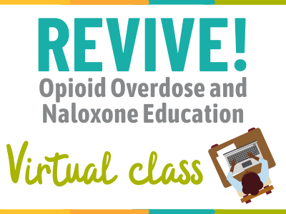
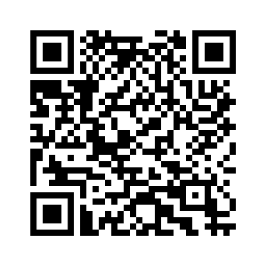
REVIVE!
REVIVE! trains individuals on:
How to recognize the signs and symptoms of an opioid overdose
How to administer naloxone to potentially reverse the effects of an opioid overdose
What to do and not do when responding
Each attendee receives a free REVIVE! kit, which includes all the supplies needed to administer naloxone.
Spanish Course Available
More information and upcoming training dates: http://bit.ly/revive-csb
Scan this QR code for more information.
Notes:
CSB – Marla
Will review what’s on the slide

Slide 20
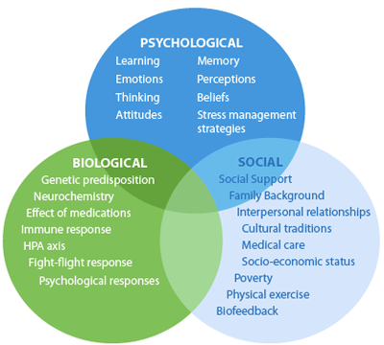
What Makes Students Vulnerable to Substance Abuse?
Peers who use substances
Poor Parental Monitoring
Stress
Mental health concerns
Family History of Addiction
Environment
Adverse Childhood Experiences (ACEs)
Trauma
Personal
Family
Favorable parental attitudes toward the behavior
Rejection of sexual orientation or gender identity
Lack of school connectedness
Centers for Disease Control www.cdc.gov

Slide 21
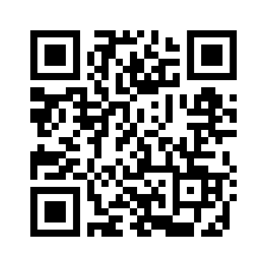
Prevention Strategies
Talk to your child about drugs
60 min lecture vs 60 (1) minute talks
Talking in the car
Eat dinner together
Have an “escape” plan when you child is uncomfortable
Role play scenarios
Talk about family history
Monitor use of prescription medications/ keep them locked
Search rooms, back packs and internet history
Parental supervision-check-in with other parents
Get child/family treatment for trauma, grief, family addiction, mental health concerns, etc.
Be clear about family rules and expectation. Stick to the consequences
SAMHSA-Talk They Hear You
Talk They Hear You

Slide 22
Understanding Why People Use
Actual Drug Use
Social anxiety
Depression
Anxiety
Trauma
Emotional abuse
Bullied
Loss
Relationships

Slide 23
Resources
Kelly Rankin LCSW, CSAC
Krankin@fcps.edu
703-287-2744
Fairfax County Community Services Board
FCPS Substance Abuse Prevention Program

