Slide 1
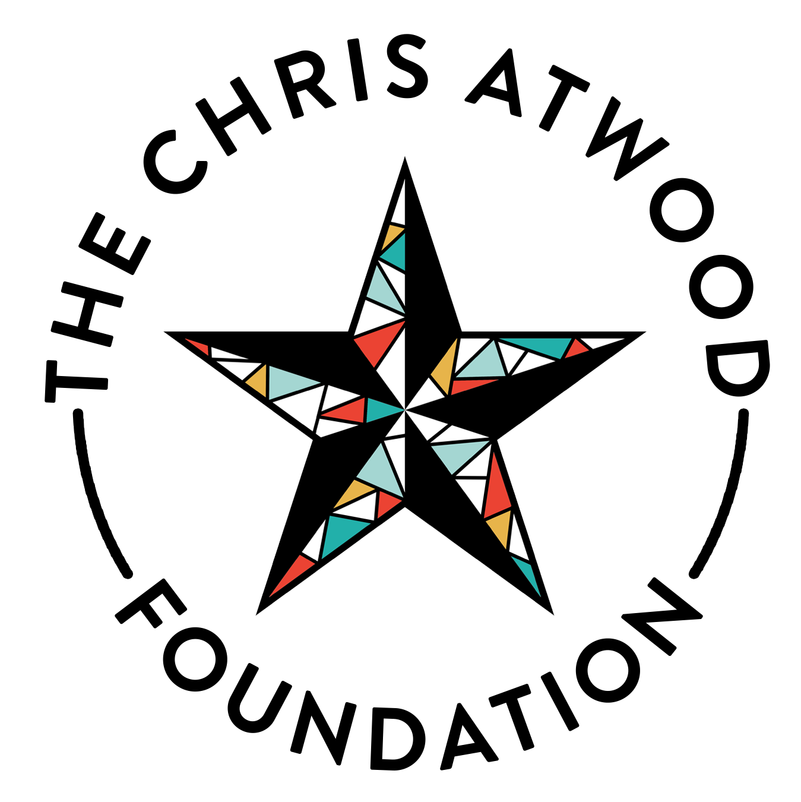

Slide 2
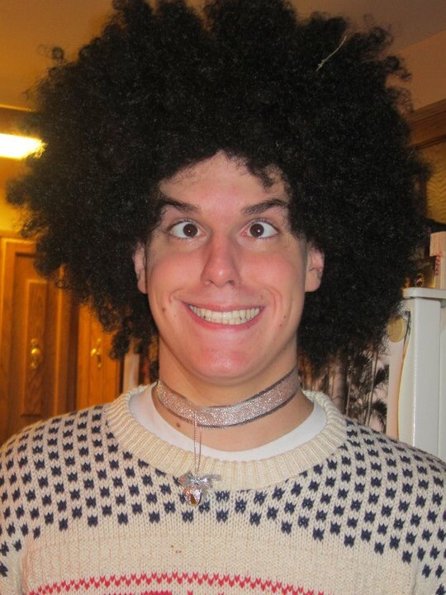

Slide 3
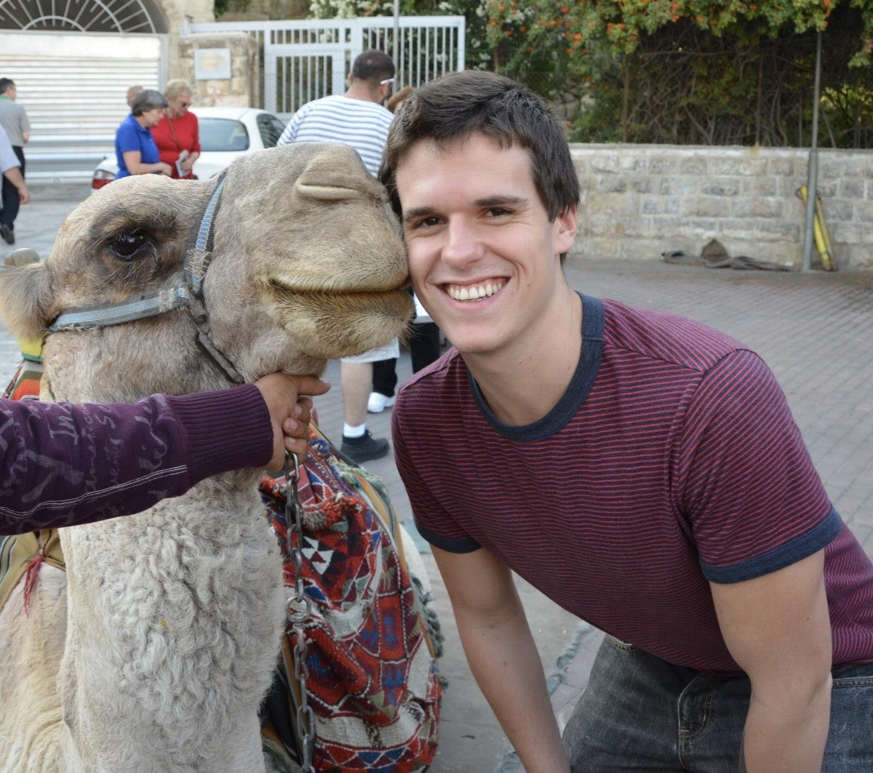

Slide 4
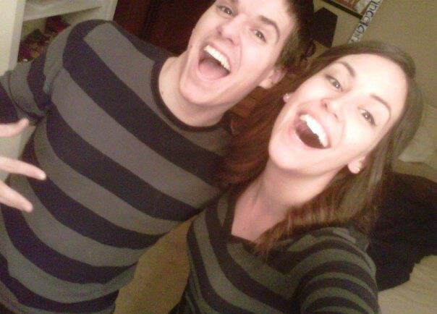

Slide 5
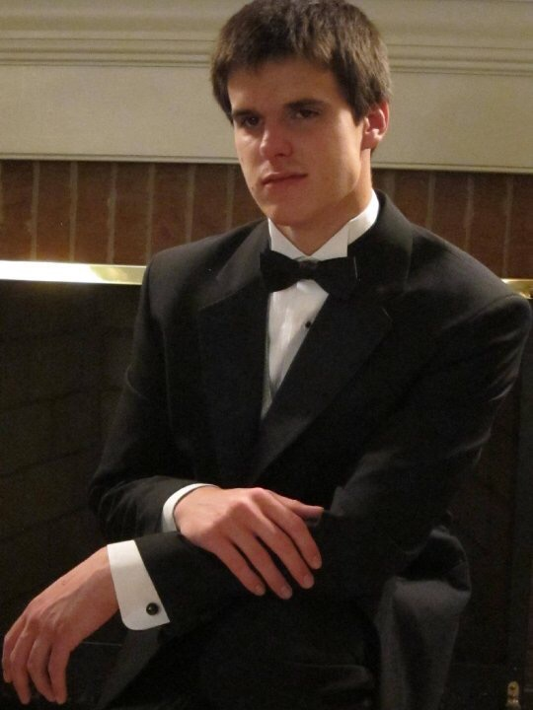

Slide 6
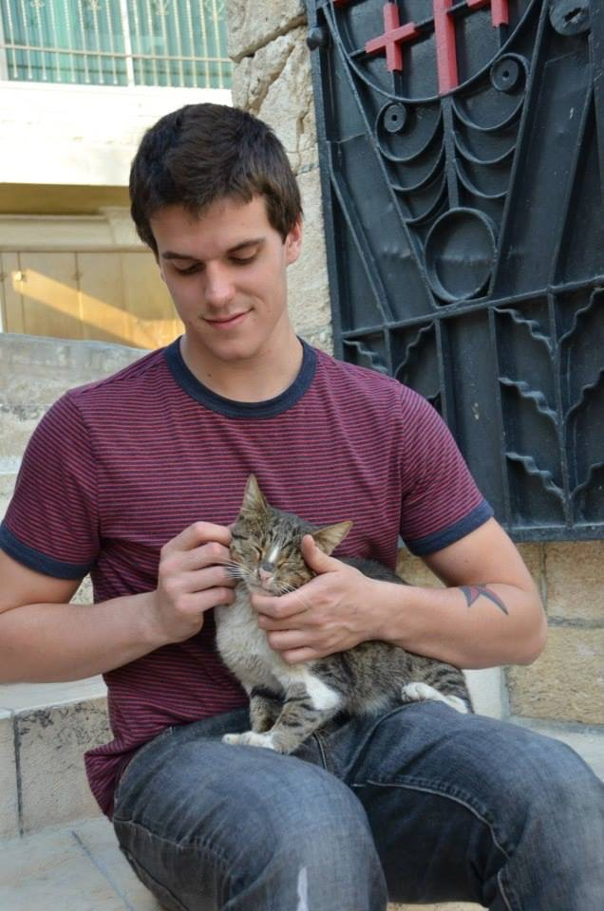

Slide 7
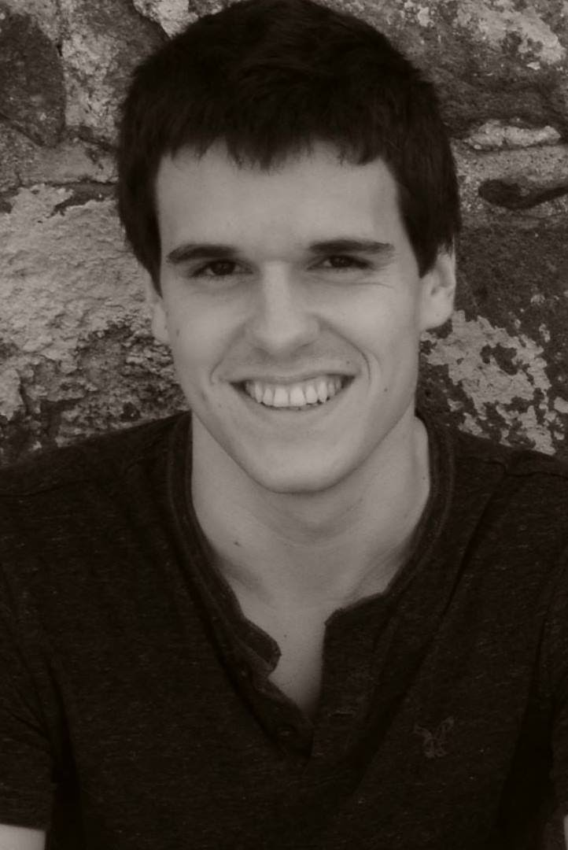
OUR STORY
Founded in 2013 by The Atwood Family following the loss of Christopher to an accidental overdose at the age of 21.
The Mission: To save lives and support recovery from substance use disorder.
Notes:
HYBRID recovery community organization - which means that we provide both harm reduction and recovery support services. We believe that this integration has been and will continue to be critical to the success of our members in their recovery goals.

Slide 9
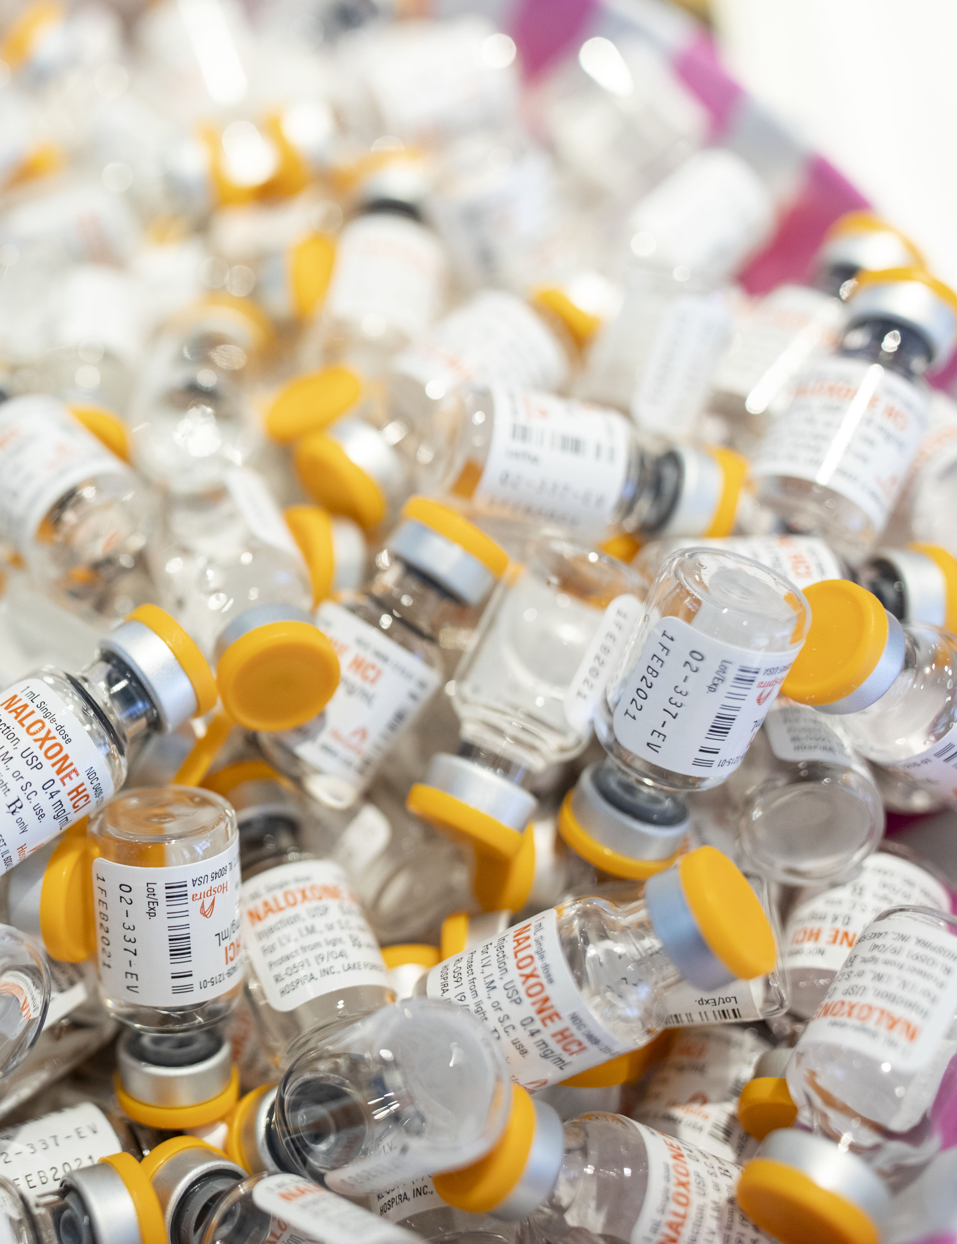
Image goes here
OVERDOSE PREVENTION
Distributed over 110,000 doses of free Naloxone
More than 1,800 reported lives saved
300+ new Revive Trainers
Statewide mailing program – 130 of 133 counties and cities
Notes:
One-stop shopping for recovery: an investigation of participant characteristics and benefits derived from U.S. Recovery Community Centers John F. Kelly1, Robert L. Stout3, Leonard A. Jason2, Nilofar Fallah-Sohy1, Lauren A. Hoffman1, Bettina B. Hoeppner1 1Recovery Research Institute, Massachusetts General Hospital and Harvard Medical School, 151 Merrimac Street, Boston, MA 02114, Harvard Medical School 2Decision Sciences Institute, Providence, RI 3DePaul University http://www.recoveryanswers.org/assets/Kelly-Stout...-Hoeppner-2020.pdf
Kelly JF, Fallah-Sohy N, Cristello J, Stout RL, Jason LA, Hoeppner BB. Recovery community centers: Characteristics of new attendees and longitudinal investigation of the predictors and effects of participation. J Subst Abuse Treat. 2021;124:108287. doi:10.1016/j.jsat.2021.108287

Slide 10
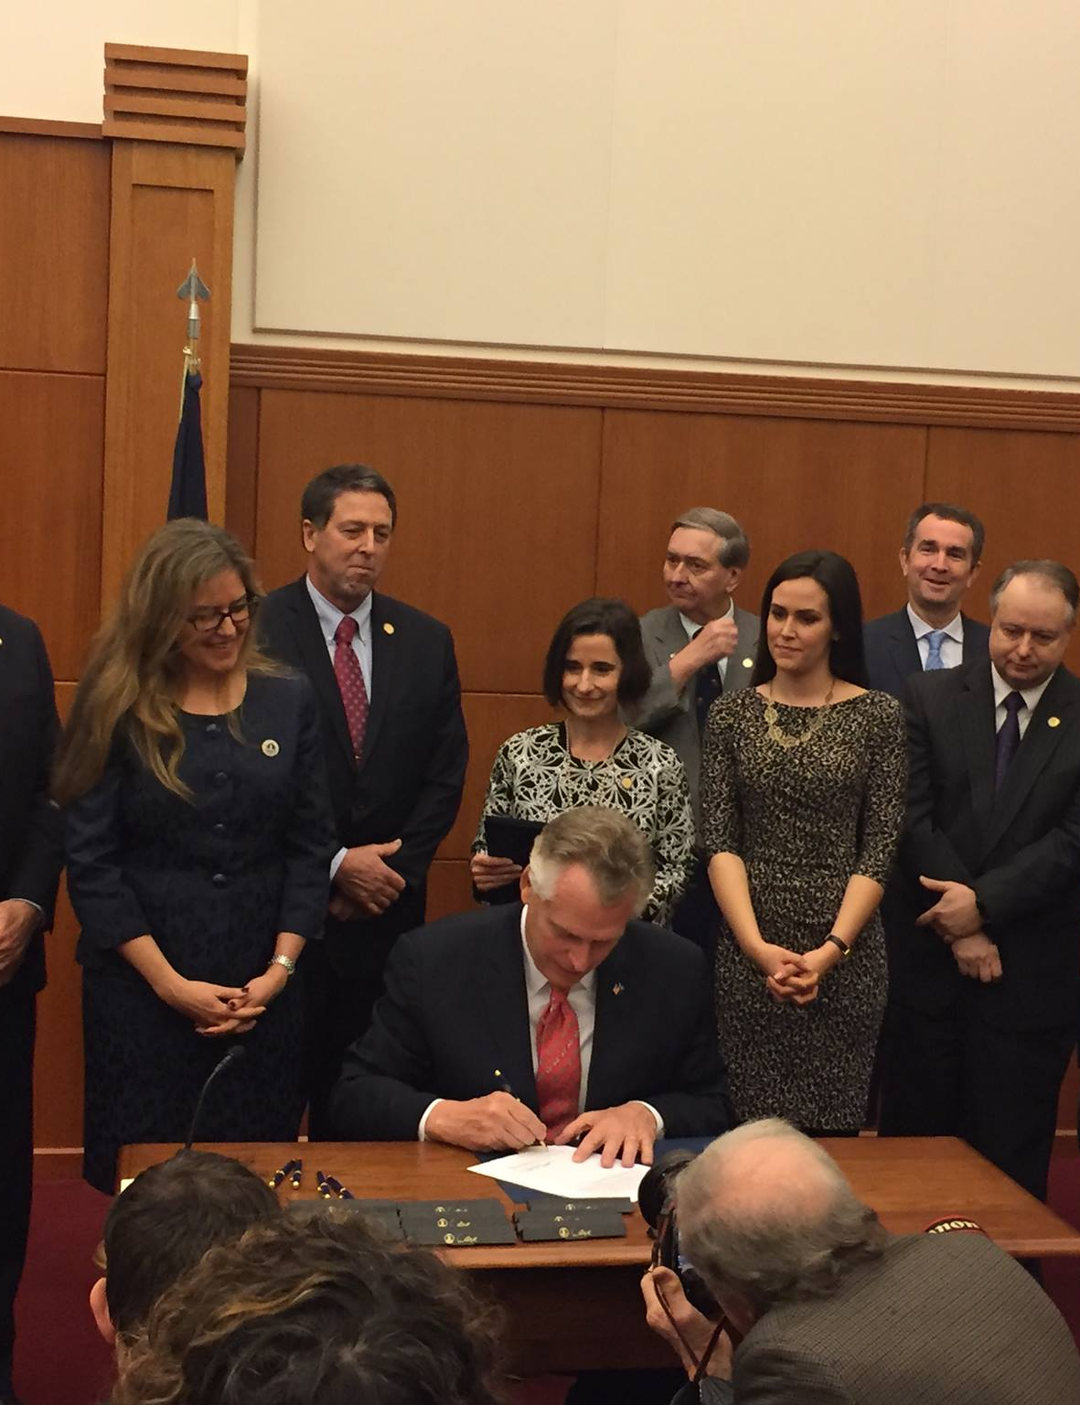
ADVOCACY
2017- Community Naloxone Distribution
2018 – Affordable naloxone access
2019 – Streamlining naloxone access
2020 – Expanding Comprehensive Harm Redution Programs
2020 - Safe Reporting of Overdoses
2021 – Danny’s Law / Emergency Department Naloxone
2022 – Expanding Danny’s Law
Notes:
Financial stability - we have grown by 30% or more year over year since inception through an emphasis on diversity in our funding portfolio.
Lived experience - The Chris Atwood Foundation is led and governed primarily by people with lived experience. Among our staff, 86% have lived experience. Our board is made up of 57% members with lived experience.
Diversity - includes consideration age, race, gender, gender identify, language, and any other cultural experiences that demonstrate a rich diversity of experience and ideas.
List of MOUs in addition to those listed:
Virginia Harm Reduction Coalition for data and best practices sharing
Fairfax Methadone Treatment Center for medication assisted treatment
Oxford House for recovery housing
George Mason University’s Mason and Partner Clinic for Hepatitis C treatment and medication assisted treatment
Virginia Department of Health for Narcan nasal spray and comprehensive harm reduction technical assistance
Fairfax Drug Court for member referrals and reentry coordination
Jersey Mike's Subs for employment opportunities
Direct Relief for intermuscular injected naloxone
NOVA Salud for disease testing and peer support services for HIV positive individuals

Slide 11
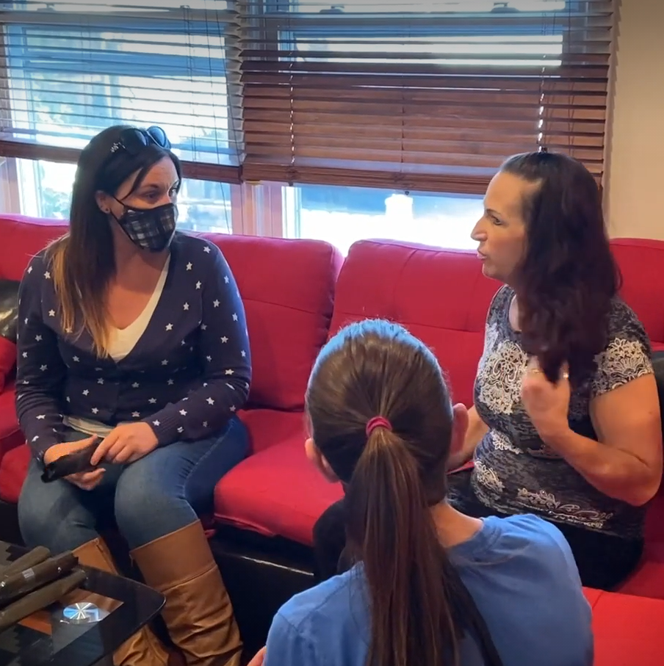
RECOVERY HOUSING
Average of 200 people placed in recovery housing annually
Bedding and basic household supplies
Narcan
Medication lock boxes
Peer Coaching

Slide 12
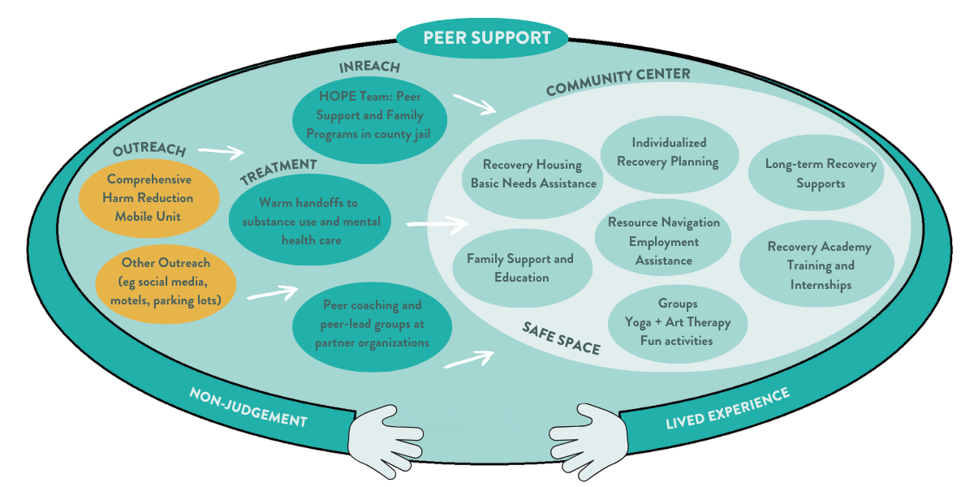
REVIVE TO THRIVE
A peer centered continuum of care

Slide 13
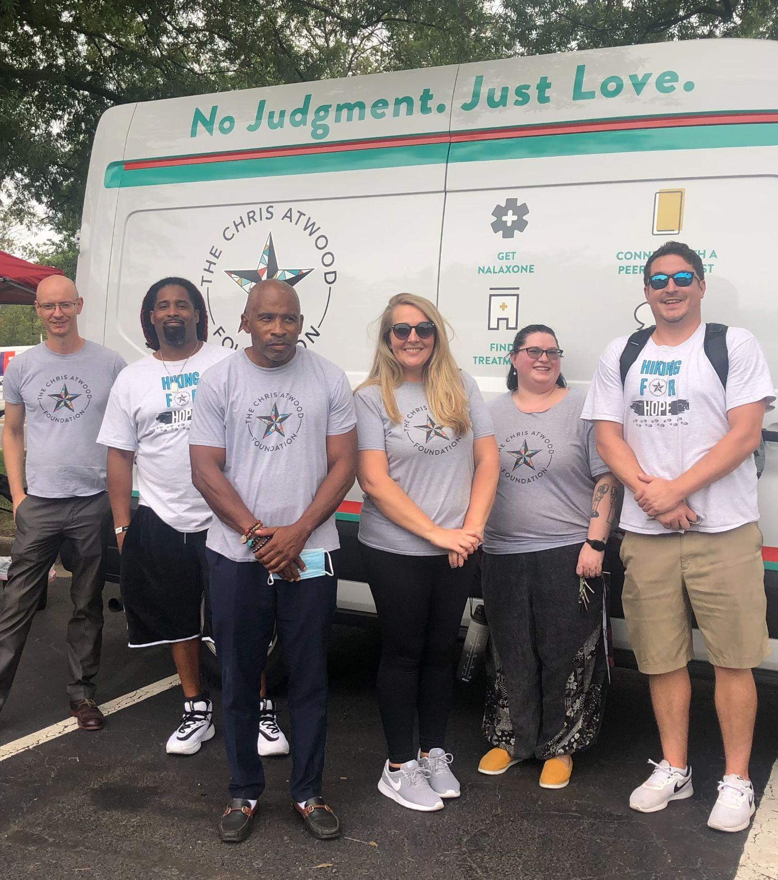
Comprehensive
Harm
Reduction
500+ members
Mobile syringe access and disposal
Run by CPRS
HIV / HCV testing
Narcan
Fentanyl Test Strips
Participants 5x more likely to enter treatment
Reduces HIV rates by 50% in the communities they are located
Notes:
180 individuals having received peer support coaching
500 individuals having received brief encounter services (stop in to get Narcan, receive a
resource referral)
50 families having received family support services
25 Peer-facilitated Support groups held
8 new peer support specialists completing DBHDS certification

Slide 14
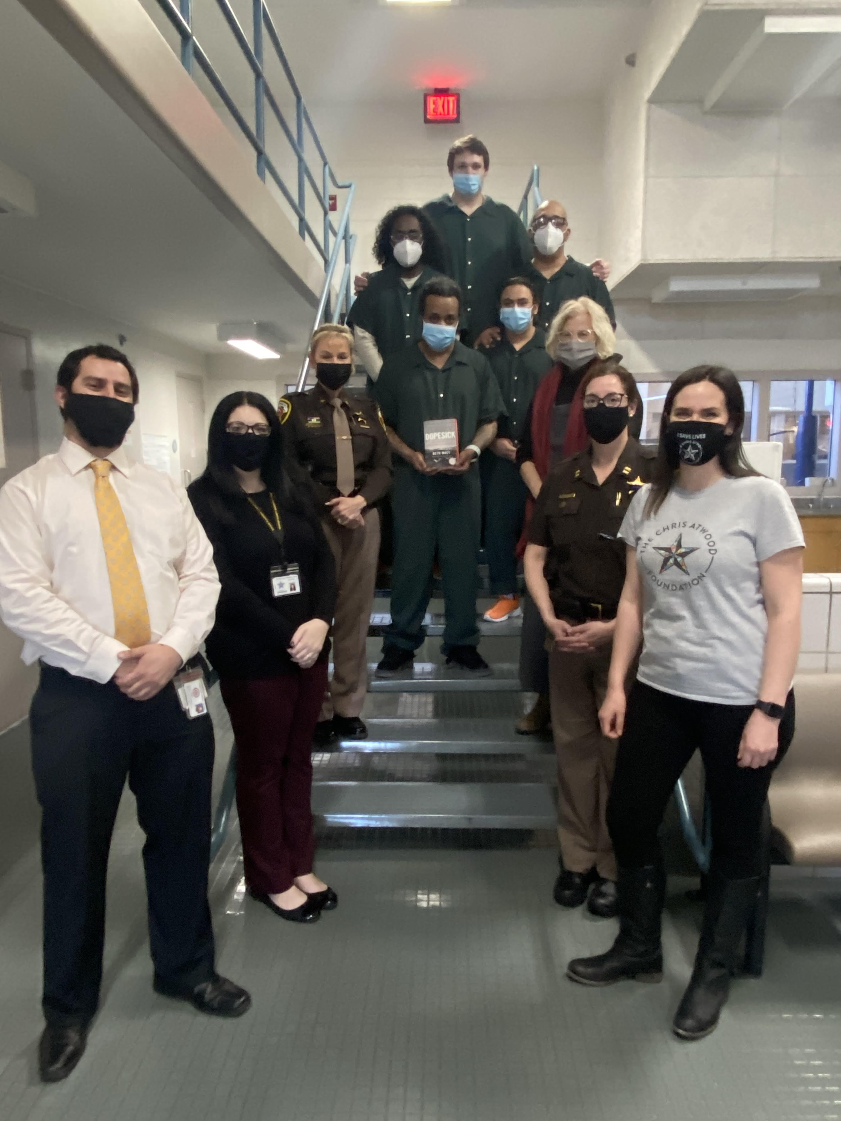
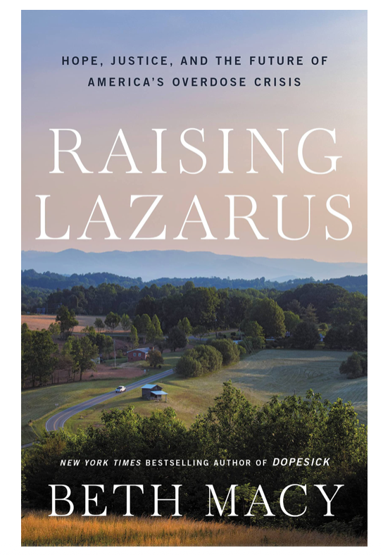
Image goes here
HOPE TEAM
Peer Support and Re-entry coordination for incarcerated individuals with SUD.
Over 400 people served since 2020 with:
Coaching
Employment Support
Housing grants
Phones
Naloxone
Training
Medication support
Written about in best selling author Beth Macy’s new book!
Notes:
One-stop shopping for recovery: an investigation of participant characteristics and benefits derived from U.S. Recovery Community Centers John F. Kelly1, Robert L. Stout3, Leonard A. Jason2, Nilofar Fallah-Sohy1, Lauren A. Hoffman1, Bettina B. Hoeppner1 1Recovery Research Institute, Massachusetts General Hospital and Harvard Medical School, 151 Merrimac Street, Boston, MA 02114, Harvard Medical School 2Decision Sciences Institute, Providence, RI 3DePaul University http://www.recoveryanswers.org/assets/Kelly-Stout...-Hoeppner-2020.pdf
Kelly JF, Fallah-Sohy N, Cristello J, Stout RL, Jason LA, Hoeppner BB. Recovery community centers: Characteristics of new attendees and longitudinal investigation of the predictors and effects of participation. J Subst Abuse Treat. 2021;124:108287. doi:10.1016/j.jsat.2021.108287

Slide 15
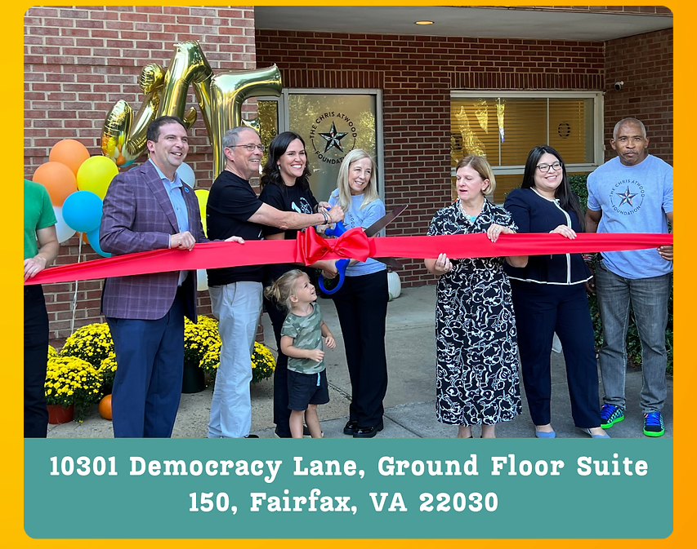
RECOVERY COMMUNITY
CENTER
A safe space
Private counseling rooms
Support group meetings
Training academy
More services coming soon!

Slide 16
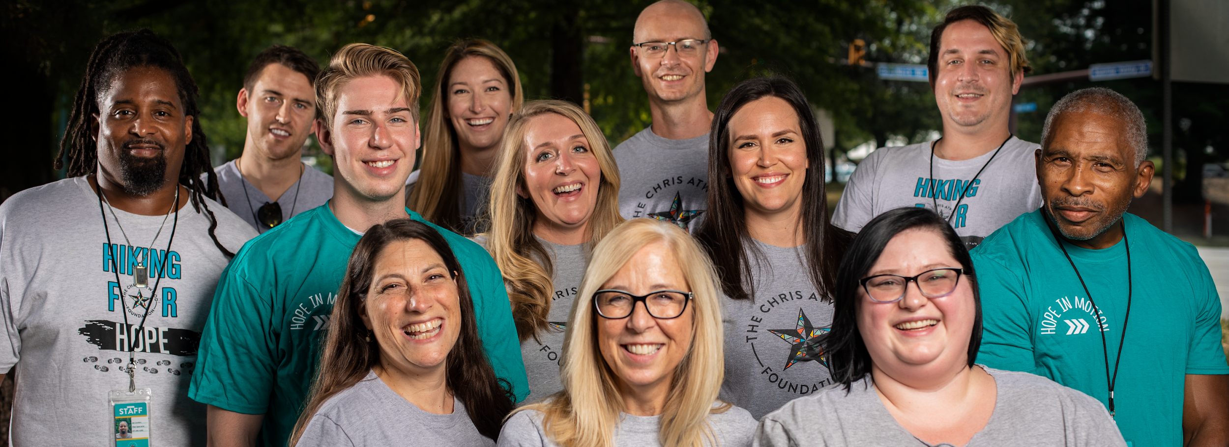
GROWING TO MEET THE NEED
Tripled both staff size and budget during the pandemic.
Launched two evidence-based programs that were not previously available in Northern Virginia
Opened Recovery Center in July 2023

Slide 17
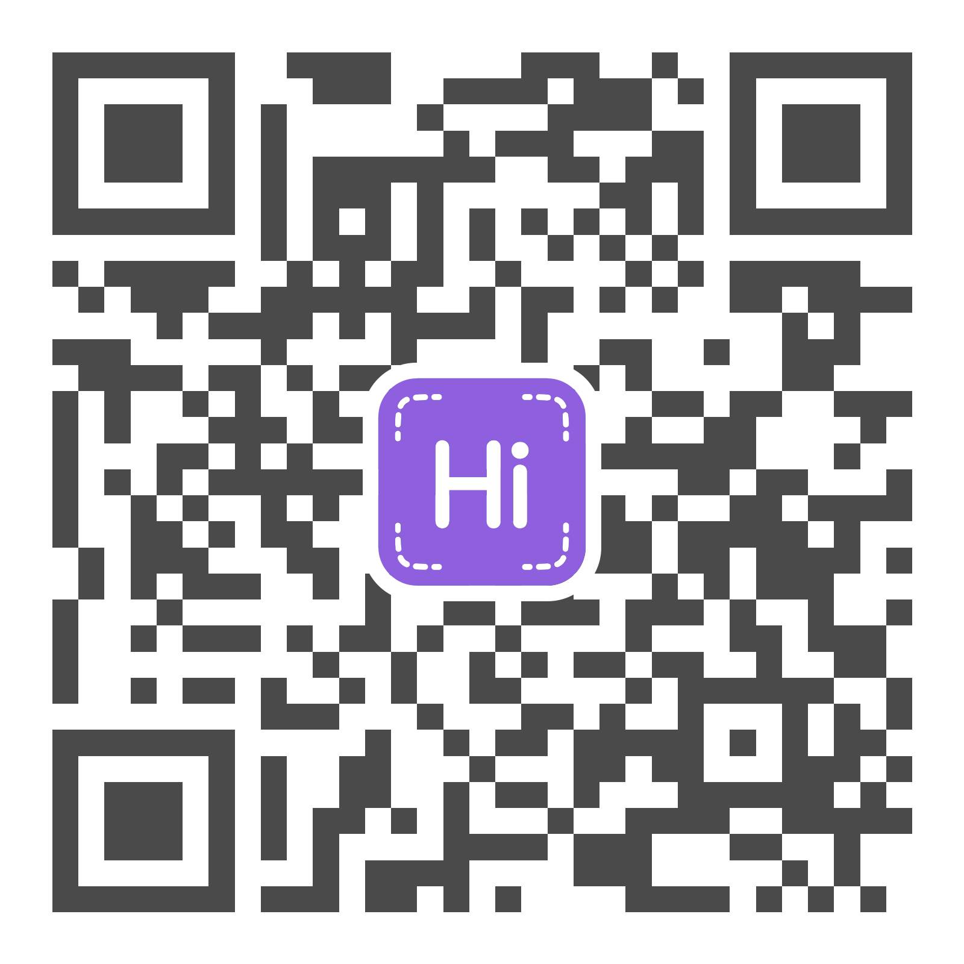
Contact Me:
Ginny Atwood Lovitt
Ginnylovitt@thecaf.org
703-489-0402

